Slide 1
IME653 Unstructured Data Analysis Term Project Final Presentation
Predicting the MLB game results based on the daily previews
Jihee Han (2015010350)
Jisun Lee (2012021577)
Dongjin Seo (2014021498)
Department of Industrial Management Engineering
Korea University
2015. 6. 16

Slide 2
Agenda
Goal of the project
Previous works
Experiment results
Conclusion

Slide 3

Goal of the project
Goal of the project
Proposing a methodology to predict the MLB game results based on the each daily previews by using text mining and classification techniques

Slide 4
Process
Collect the text information
ex] Daily previews from web and the corresponding actual game results
Developing and extracting the features
ex] Term frequency, variety of terms based on daily previews of each MLB games
Building a data matrix
Actual game results based on the extracted features
[Text mining techniques]
Building a classification model with the data matrix
[Classification techniques]
For prediction of the each game results
Testing the performance of the classification model
How accurately predict the each game results compared to others

Slide 5


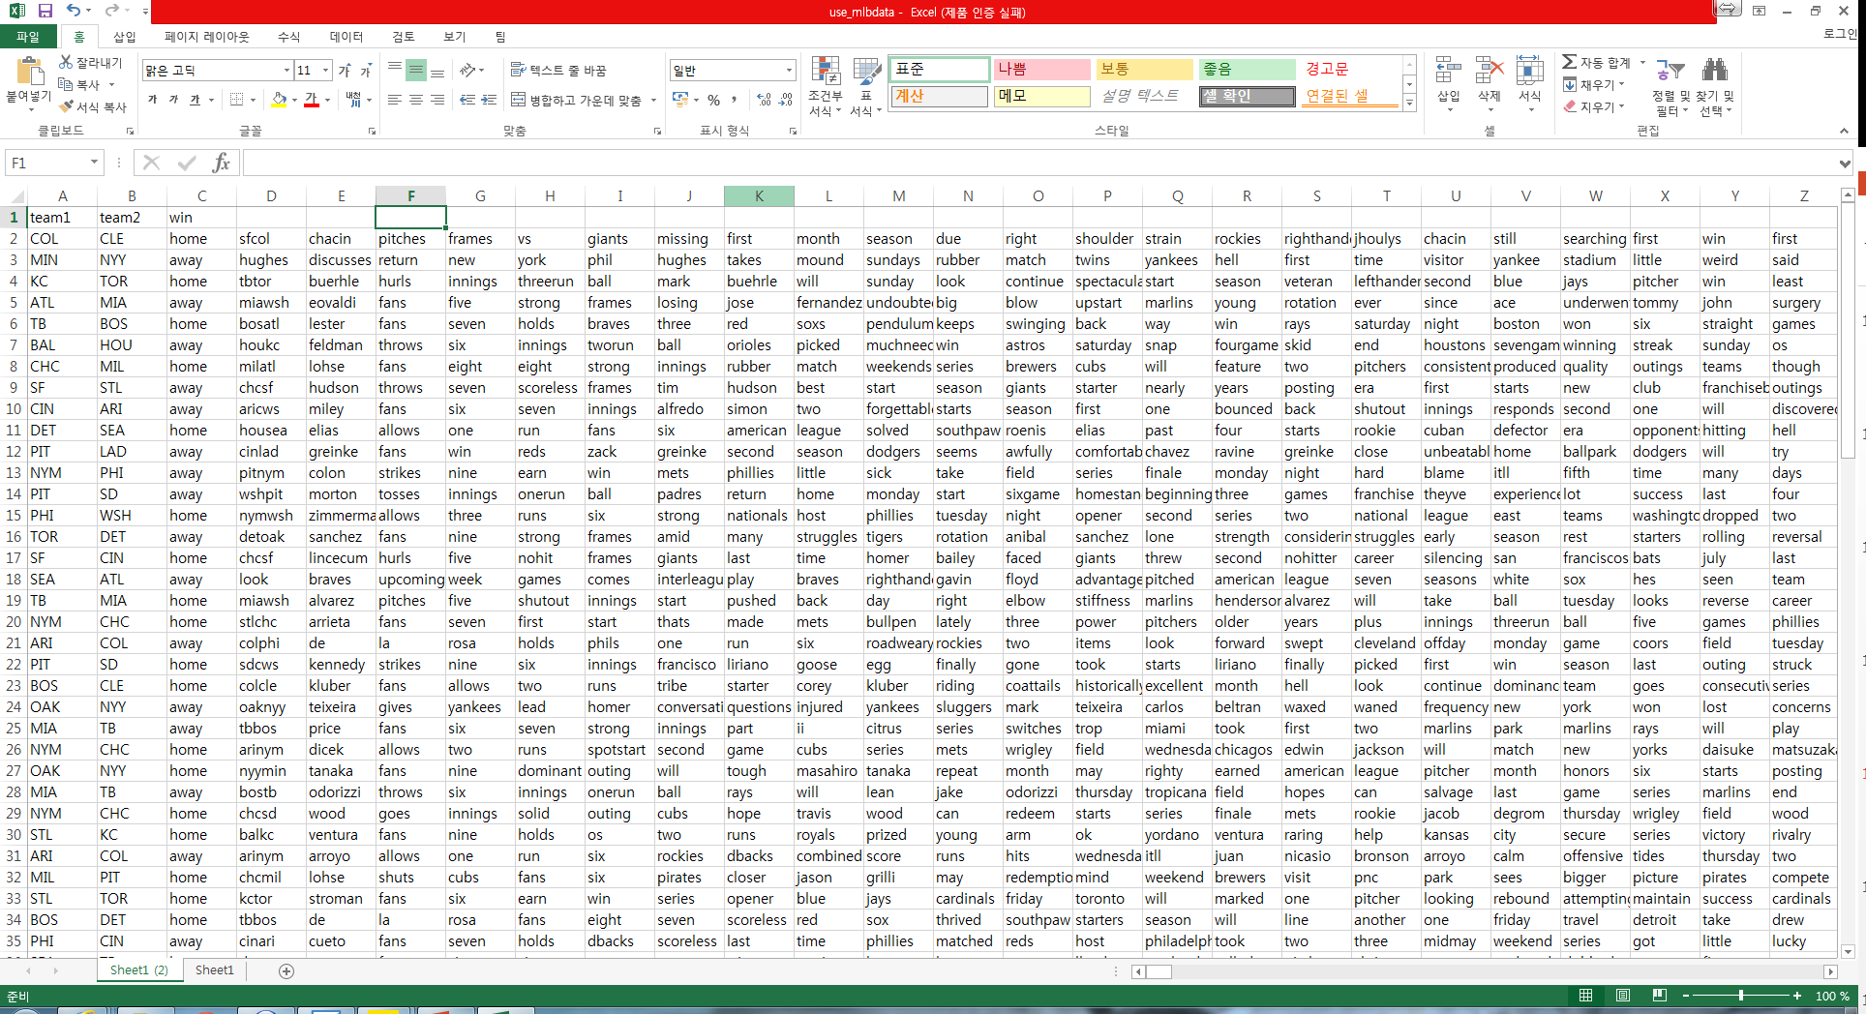
Previous works
Web site -> pre-processed text
Tool : R studio

Slide 6
Devising the features
Features list
Term frequency
Frequency of away team name in an entire article
Frequency of home team name in an entire article
Frequency of away team’s athlete name in an entire article
Frequency of home team’s athlete name in an entire article
Term order
Location of away team name in an entire article
Location of home team name in an entire article
Location of away team’s athlete name in an entire article
Location of home team’s athlete name in an entire article

Slide 7
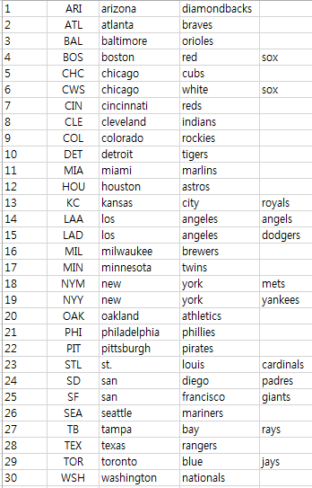
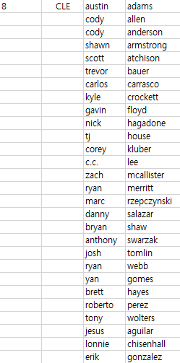
Developing data matrix for classification
Necessary pre-data
List of all teams Full name of all athletes in each teams

Slide 8
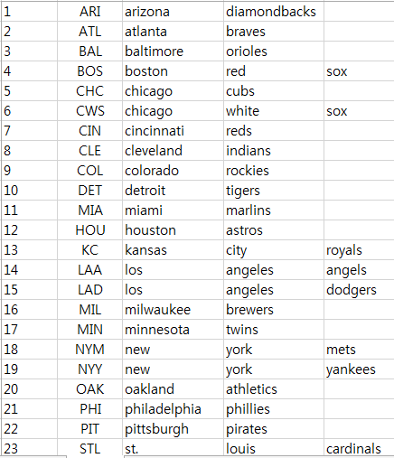
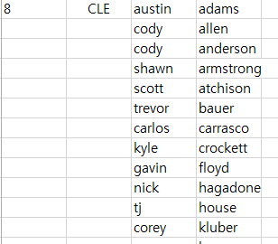
Developing data matrix for classification
Creating the data matrix from pre-processed article and developed features
Pre-processed article + team list + athletes list
 | Feature1 | Feature2 | Feature3 | Feature4 | Feature5 | … | Class (Winning team)
Article 1 | 1 | 1 | 1 | 1 | 1 |  | 1
Article 2 | 2 | 1 | 2 | 1 | 0 |  | 2
… |  |  |  |  |  |  | …
Article n | 1 | 2 | 1 | 2 | 0 | … | 1

Slide 9
Calculating the features
Tool : Matlab 2013b
Data read
%read a preprocessed article
txt_main = xlsread('C:\Users\isd\Desktop\mlbpredict\maindata.xlsx');
%get the index of home/away team from teamlist
idx_away = find(ismember(txt_team(:,2), txt_main(1)));
idx_home = find(ismember(txt_team(:,2), txt_main(2)));

Slide 10
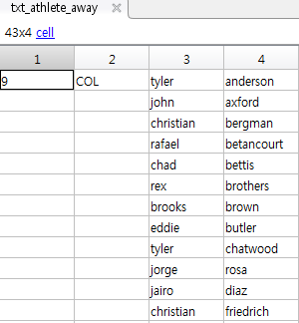
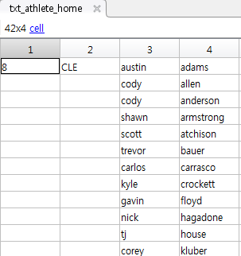
Calculating the features
Data read
%read the athlete’s names from athlete_list regarding home/away team
txt_athlete_away = xlsread('C:\Users\isd\Desktop\mlbpredict\athletelist.xlsx', idx_away);
txt_athlete_home = xlsread('C:\Users\isd\Desktop\mlbpredict\athletelist.xlsx', idx_home);

Slide 11
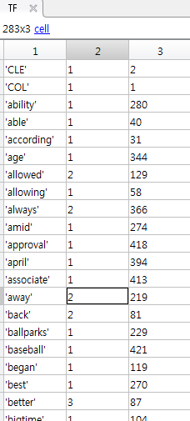






Calculating the features
Making Term-Frequency and order table
[term, firstloc, freq] = unique(txt_main);
TF = [term freq firstloc];
Calculating Term frequency of team name
%Team name vectors
%Index of team names in TF
idx_TF_teamaway = find(ismember(term, name_away));
idx_TF_teamhome = find(ismember(term, name_home));
Frequency of team names
Output

Slide 12
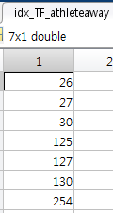
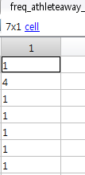

Calculating the features
Calculating Term frequency of athlete name
Athlete name that have been mentioned in the article
Output

Slide 13
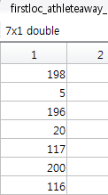
Calculating the features
Term order
Can be done using TF as well
Finding the when team names have been mentioned in the article
Output
Finding the when athletes names have been mentioned in the article
Output

Slide 14
Data matrix for classification
Data matrix output by repeating the procedure
 | Freq_ team away | Freq_ team home | Freq_ athlete away | Freq_ athlete home | Firstloc_ team away | Firstloc_ team home | Firstloc_athlete away | Firstloc_athlete home | Class
article1 | 12 | 6 | 10 | 13 | 18 | 50 | 5 | 111 | 2
article2 | 7 | 18 | 11 | 9 | 16 | 7 | 4 | 183 | 1
article3 | 16 | 16 | 5 | 13 | 92 | 22 | 229 | 11 | 2
article4 | 10 | 10 | 8 | 8 | 54 | 17 | 18 | 12 | 1
article5 | 18 | 21 | 5 | 4 | 19 | 11 | 208 | 250 | 2
article6 | 7 | 8 | 8 | 16 | 11 | 15 | 30 | 5 | 1
article7 | 7 | 16 | 10 | 14 | 16 | 15 | 215 | 5 | 2
article8 | 7 | 9 | 12 | 15 | 15 | 48 | 5 | 112 | 1
article9 | 7 | 3 | 6 | 6 | 36 | 233 | 142 | 234 | 1
article10 | 6 | 9 | 6 | 22 | 36 | 32 | 348 | 5 | 2
article11 | 11 | 8 | 2 | 11 | 30 | 13 | 215 | 5 | 1
…
article172 | 4 | 12 | 6 | 15 | 45 | 35 | 135 | 5 | 2

Slide 15
Classification using SVM
Feature scaling [0, 1]
K-cross validation
k=5;
cvFolds = crossvalind('Kfold', dataclass, k);
SVM for classifier
RBF kernel: Default values for parameters
%run SVM
SVMStruct = svmtrain(traindata,trainclass, 'kernel_function', 'rbf');
resultclass = svmclassify(SVMStruct,testdata);
%confusion matrix
[C, order] = confusionmat(actualclass, resultclass);
%performance evaluation
accuracy = trace(C)/sum(sum(C));
sensitivity = C(1,1)/(C(1,1) + C(1,2));
specificity = C(2,2)/(C(2,1) + C(2,2));

Slide 16
Evaluation for classification work
Measures for performance evaluation
Confusion matrix
Classification accuracy =
Sensitivity =
Specificity =
Experiment result
Classification accuracy = 0.5511
Sensitivity = 0.5050
Specificity = 0.5900
 | Predicted
Actual | Positive | Negative
Positive | True Positive(TP) | False Negative(FN)
Negative | False Positive(FP) | True Negative(TN)

Slide 17
Conclusion
Result summary
Average accuracy around 50-60%
Slightly higher specificity than sensitivity
Contribution
Predict the MLB game results using the text information like daily previews
Identify the features that play an importance role on the game results
Compare the predicting accuracy between our own methodology and others
Limitations
Same athlete names in both teams
More features by combining other indicators such as batting average, earned run average etc.

